Slide 1

Sentiment Tracker
Kelsey, Sarah, Stephan,Tyler and Kyle

Slide 2
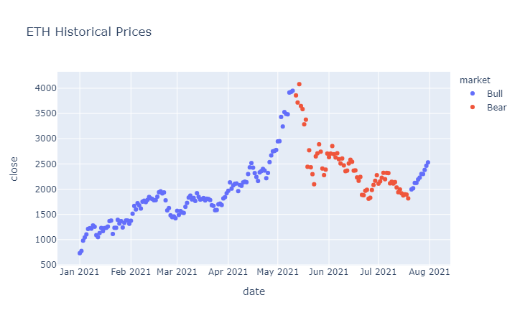
Project Objective
Identify market sentiment based on social media commentary and news headlines
Notes:
scrape sentiment data from News and Reddit and utilize machine learning to train a sentiment analyzer that identifies bullish, bearish or neutral sentiment for equities and crypto-assets.

Slide 3
Project Overview
Able to Accomplish:
Pulled API’s to scrape Reddit Comments and News Headlines
Ran a model using Vader
Able to train a RNN LSTM model with our collected data to predict market sentiment
Working Towards:
Utilize that model on near-term data to determine current market conditions
Notes:
Utilize Python API’s to scrape Reddit comments & news headlines into useable .csv formats

Slide 4


APIs & Text Acquisition
In Jupyter Lab, we utilized pre-built Python api’s to scrape text data from Ethereum-focused sources
Reddit posts & comments from r/Ethtrader, r/Ethereum and r/EthFinance
News Headlines across the internet with mention of Ethereum - Rakuten API
Formatted the commentary into timestamped .csv data
Prepped Data for Machine Learning Analysis:
Applied Bull market, Bear market or Neutral market conditions to each piece of data based on the market conditions at the time of the post or headline.

Slide 5
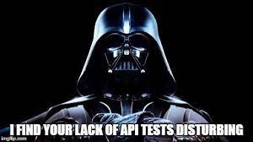
Model Training & Comparison
Vader Analysis
We utilized Vader’s native NLP library and capabilities to classify comments as positive/negative or neutral
Accuracy = 3%
RNN LSTM Model
Tokenized the comments & performed a Train/Test/Split analysis to train a model on binary values representing the market conditions at the time of the comment or news headline

Slide 6
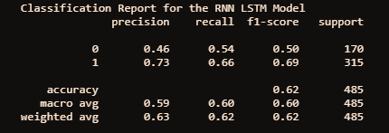
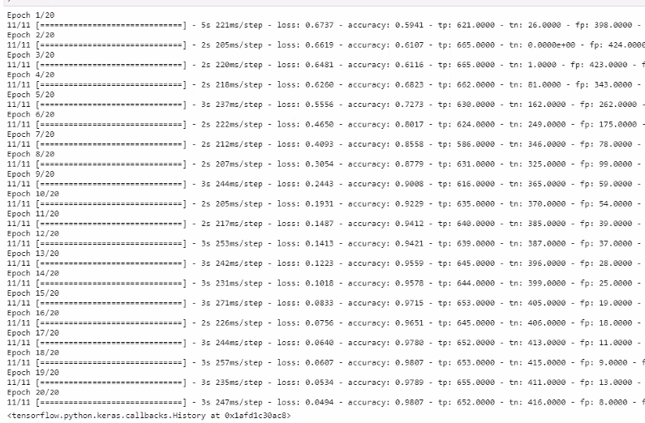
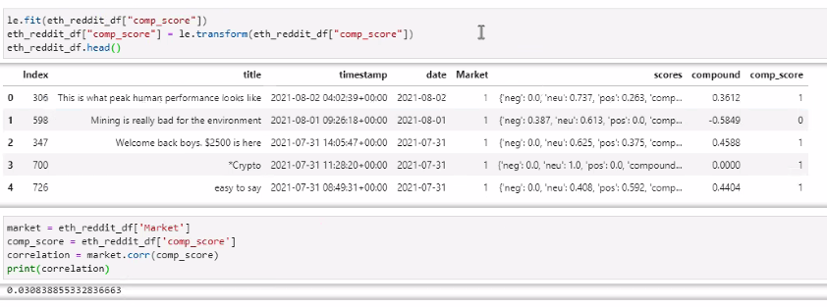
Reddit Model Results & Future Use
RNN LSTM Results
RNN LSTM was 62% accurate/correlated in testing the model for market conditions
Confidence in model?

Slide 7
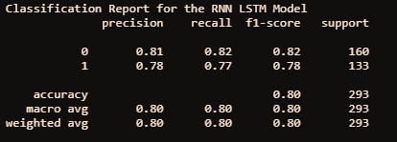
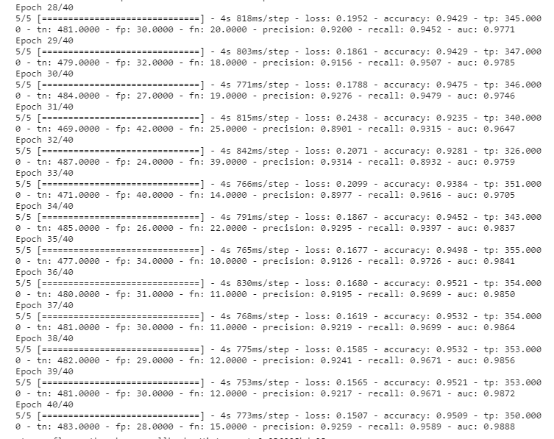
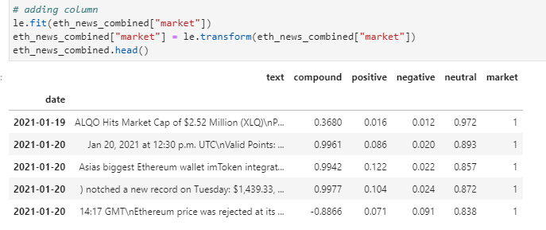
News Model Results & Future Use
RNN LSTM Results
RNN LSTM was 80% accurate/correlated in testing the model for market conditions
Confidence in model?

Slide 8
Areas for Improvement
Sourcing & Modeling:
Pull in more data
Utilize additional sources to reduce potential bias
Try different models to find a better fit
Final Result:
Able to apply the model real-time to predict current sentiment
Plot sentiment against price to see how it lags or predicts a future price move

Slide 9
Takeaways
We were able to gather enough data to build a model that predicts market sentiment based on Reddit and news comments.
Our models were far from perfect, but able to get above 50% accuracy. If we had time to gather more data or try different models we could enhance our prediction accuracy.

